Slide 1
Syntax Directed Definition
Vallurupalli Nageswara Rao Vignana Jyothi Institute of Engineering &Technology

Slide 2
Agenda
4.1
1.Syntax-Directed Definitions and Translation schemes
2.Synthesized and inherited attributes
3.SDD for desk calculator
4.Annotated parse tree
5.Attributed grammar
6.SDD for inherited attributes
7.Dependency graph
8.Abstract syntax trees and DAG
9. Syntax tree creation using SDD

Slide 3
Agenda
4.2
4.3
Run time environment
Storage organization
Activation tree and activation record
Storage allocation methods
Intermediate code generation - benefits
Intermediate code representations – syntax tree, DAG, post fix notation and Three address code forms
Types of three address code
Implementation of three address code-quadruples, tripuls and indirect triples
Three address code for programming language constructs
5.1 Three address code for assignment statement using SDD
5.2 Three address code for Boolean expression using SDD
5.3 Three address code for control flow statements using SDD

Slide 4
Syntax-Directed Definitions and Translation Schemes
We can associate information with a language construct by attaching attributes to the grammar symbols.
A syntax directed definition specifies the values of attributes by associating semantic rules with the grammar productions.
Values of these attributes are evaluated by the semantic rules associated with the production rules.
Evaluation of these semantic rules:
may generate intermediate codes
may put information into the symbol table
may perform type checking
may issue error messages
An attribute may hold almost any thing.
a string, a number, a memory location, a complex record.

Slide 5
Syntax-Directed Definitions and Translation Schemes
When we associate semantic rules with productions, we use two notations:
Syntax-Directed Definitions
Translation Schemes
Syntax-Directed Definitions:
give high-level specifications for translations
hide many implementation details such as order of evaluation of semantic actions.
We associate a production rule with a set of semantic actions, and we do not say when they will be evaluated.
Translation Schemes:
indicate the order of evaluation of semantic actions associated with a production rule.
In other words, translation schemes give a little bit information about implementation details.

Slide 6
Syntax-Directed Definitions
A syntax-directed definition is a generalization of a context-free grammar in which:
Each grammar symbol is associated with a set of attributes.
This set of attributes for a grammar symbol is partitioned into two subsets called synthesized and inherited attributes of that grammar symbol.
Each production rule is associated with a set of semantic rules.
SYNTHESIZED attributes are computed from the values of the CHILDREN of a node in the parse tree.
INHERITED attributes are computed from the attributes of the parents and/or siblings of a node in the parse tree.

Slide 7
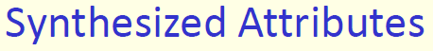
A syntax directed definition that uses only synthesized attributes is said to be an S-attributed definition
A parse tree for an S-attributed definition can be annotated by evaluating semantic rules for attributes

Slide 8
Syntax-Directed Definition for Desk calculator -- Example
Production Semantic Rules
L → E return print(E.val)
E → E₁ + T E.val = E₁.val + T.val
E → T E.val = T.val
T → T₁ * F T.val = T₁.val * F.val
T → F T.val = F.val
F → ( E ) F.val = E.val
F → digit F.val = digit.lexval
Symbols E, T, and F are associated with a synthesized attribute val.
The token digit has a synthesized attribute lexval (it is assumed that it is evaluated by the lexical analyzer).

Slide 9
Annotated Parse Tree
A parse tree showing the values of attributes at each node is called an annotated parse tree.
The process of computing the attributes values at the nodes is called annotating (or decorating) of the parse tree.

Slide 10
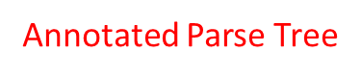
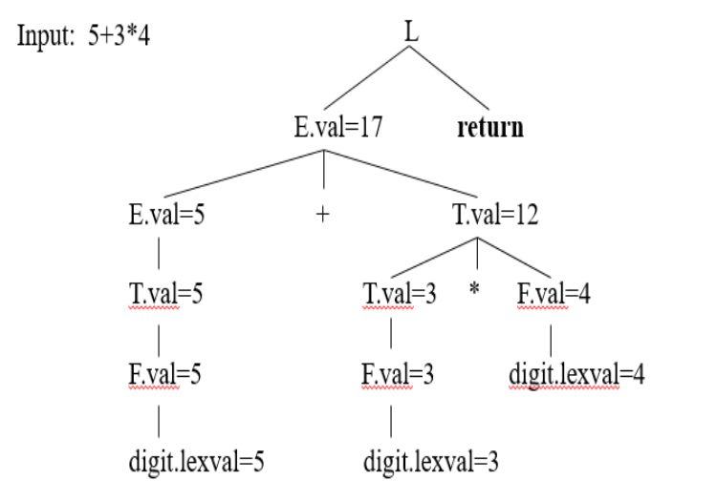
Parse tree for 5 + 3 * 5

Slide 11
Syntax-Directed Definition – Inherited Attributes
Production Semantic Rules
D → T L L.in = T.type
T → int T.type = integer
T → real T.type = real
L → L₁ id L₁.in = L.in, addtype(id.entry,L.in)
L → id addtype(id.entry,L.in)
Symbol T is associated with a synthesized attribute type.
Symbol L is associated with an inherited attribute in.

Slide 12
A Dependency Graph – Inherited Attributes
Input: real p q
D L.in=real
T L T.type=real L₁.in=real addtype(q,real)
real L id addtype(p,real) id.entry=q
id id.entry=p
parse tree dependency graph

Slide 13
S-Attributed Definitions
We will look at two sub-classes of the syntax-directed definitions:
S-Attributed Definitions: only synthesized attributes used in the syntax-directed definitions.
L-Attributed Definitions: in addition to synthesized attributes, we may also use inherited attributes in a restricted fashion.
To implement S-Attributed Definitions and L-Attributed Definitions are easy (we can evaluate semantic rules in a single pass during the parsing).
Implementations of S-attributed Definitions are a little bit easier than implementations of L-Attributed Definitions

Slide 14
Abstract Syntax tree
Condensed form of parse tree
useful for representing language constructs.
A concrete syntax tree represents the source text exactly in parsed form.
The abstract syntax tree is the result of simplifying the concrete syntax tree
Uses of AST
AST is used in Intermediate code representation(IR)

Slide 15
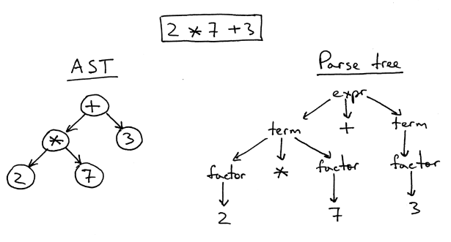
Abstract Syntax tree-definition
An abstract syntax tree (AST) is a tree that represents the abstract syntactic structure of a language construct where each interior node and the root node represents an operator, and the children of the node represent the operands of that operator.

Slide 16
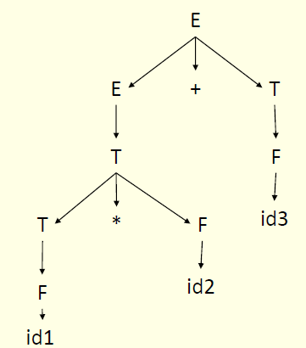
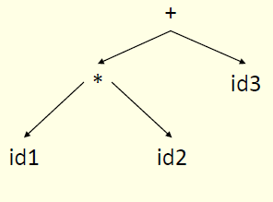
Abstract Syntax tree …

Slide 17
Abstract Syntax tree …

Slide 18
Constructing Abstract Syntax Tree for expression
Each node can be represented as a record
• operators: one field for operator, remaining fields ptrs to operands mknode(op,left,right )
• identifier: one field with label id and another ptr to symbol table mkleaf(id,entry)
• number: one field with label num and another to keep the value of the number mkleaf(num,val)

Slide 19
Example
The following sequence of function calls creates a parse tree for a- 4 + c
P1 = mkleaf(id, entry.a)
P2 = mkleaf(num, 4)
P3 = mknode(-, P1, P2)
P4 = mkleaf(id, entry.c)
P5 = mknode(+, P3, P4)

Slide 20
A syntax directed definition for constructing
syntax tree or DAG(directed acyclic graph)
Production
Semantic Rule
E → E1 + T E.ptr = mknode(+, E1.ptr, T.ptr)
E → T E.ptr = T.ptr
T → T1 * F T.ptr := mknode(*, T1.ptr, F.ptr)
T → F T.ptr := F.ptr
F → (E) F.ptr := E.ptr
F → id F.ptr := mkleaf(id, entry.id)
F → num F.ptr := mkleaf(num,val)

Slide 21
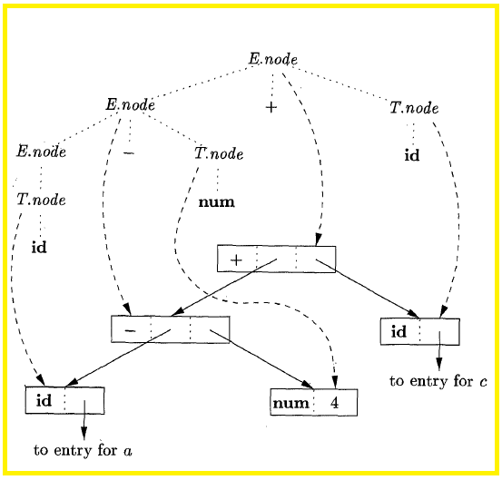
Syntax Tree
Using SDD

Slide 22
A syntax directed definition for constructing
DAG(directed acyclic graph)
Production
Semantic Rule
E → E1 + T E.ptr = mknode(+, E1.ptr, T.ptr)
E → T E.ptr = T.ptr
T → T1 * F T.ptr := mknode(*, T1.ptr, F.ptr)
T → F T.ptr := F.ptr
F → (E) F.ptr := E.ptr
F → id F.ptr := mkleaf(id, entry.id)
F → num F.ptr := mkleaf(num,val)

Slide 23
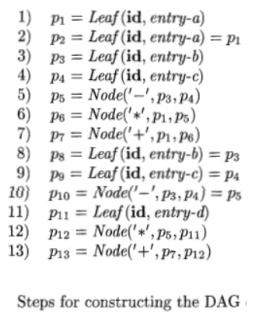
Draw the DAG for the expression
a+a*(b+c)+(b+c)*d

Slide 24
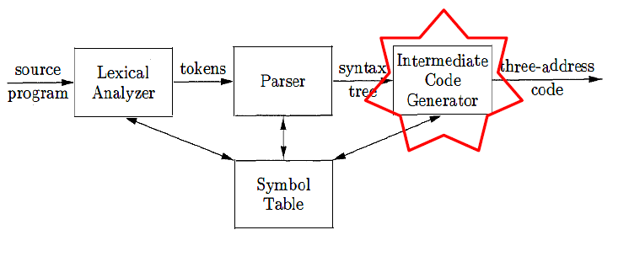
Intermediate code generation
The front end translates a source program into an intermediate representation from which the back end generates target code.

Slide 25
Intermediate code generation
Benefits of using a machine-independent intermediate form are:
Retargeting is facilitated. That is, a compiler for a different machine can be created by attaching a back end for the new machine to an existing front end.
2. A machine-independent code optimizer can be applied to the intermediate representation.

Slide 26
Intermediate code representations
Three ways of intermediate representation:
Syntax tree and DAG
Postfix notation
Three address code

Slide 27
Syntax tree and DAG
A syntax tree depicts the natural hierarchical structure of a source program. A dag (Directed Acyclic Graph) gives the same information but in a more compact way because common subexpressions are identified.
A syntax tree and dag for the assignment statement a : = b * - c + b * - c are as follows:

Slide 28
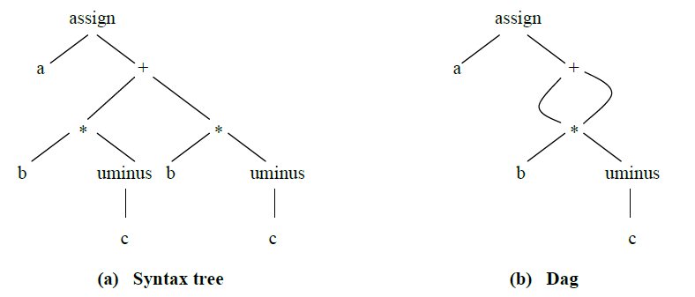
Syntax tree and DAG

Slide 29
Postfix notation
Postfix notation is a linearized representation of a syntax tree; it is a list of the nodes of the tree in which a node appears immediately after its children.
The postfix notation for the syntax tree given above is
a b c uminus * b c uminus * + assign

Slide 30
Three-Address Code:
Three-address code is a sequence of statements of the general form
x : = y op z
where x, y and z are names, constants, or compiler-generated temporaries; op stands for any operator, such as a fixed- or floating-point arithmetic operator, or a logical operator on boolean valued
data. Thus a source language expression like x+ y*z might be translated into a sequence
t1 : = y * z
t2 : = x + t1
where t1 and t2 are compiler-generated temporary names

Slide 31
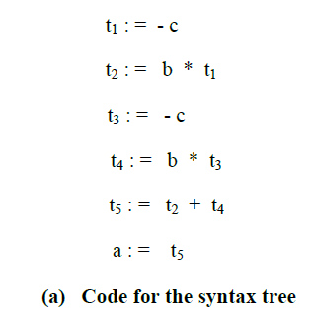
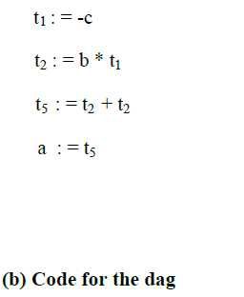
Three-address code corresponding to the syntax tree and DAG the statement : a : = b * - c + b * - c

Slide 32
Types of Three-Address Statements
Assignments:
Two possible forms:
x:= y op z where op is a binary arithmetic or logical operation,
x:= op y where op is a unary operation (minus, negation)
Copy statements:
They have the form x := y
Un-conditional jumps:
They have the form goto L where L is a symbolic label of a statement.
Conditional jumps:
They have the form if x relop y goto L where statement L is executed if x and y are in relation relop.

Slide 33
Types of Three-Address Statements
Procedure calls:
They have the form
param x₁
param x₂
.
.
.
param x_{n}
call p, n corresponding to the procedure call p(x₁, x₂, ..., x_{n})
Return statement:
They have the form return y where y representing a returned value is optional.

Slide 34
Types of Three-Address Statements
Indexed assignments:
They have the form x := y[i] or x[i] := y
Address assignments:
They have the form x := &y which sets x to the location of y.
Pointer assignments:
They have the form
x := *y where y is a pointer and which sets x to the value pointed to by y
*x := y which changes the location of the value pointed to by x.

Slide 35
Data structures to hold Three address code
OR
Three address code implementation Techniques
Three address code implementations methods:
Quadruples
Triples
Indirect triples

Slide 36
Three address code implementation Techniques
In quadruples representation, each instruction is split into the following 4 different fields : op, arg1, arg2, result
The op field is used for storing the internal code of the operator. The arg1 and arg2 fields are used for storing the two operands used. The result field is used for storing the result of the expression.
For example: x = y + z
Op (+)
Arg1 (y)
Arg2 (z)
Result (x)

Slide 37
Triples-
In triples representation,
References to the instructions are made.
Temporary variables are not used.

Slide 38
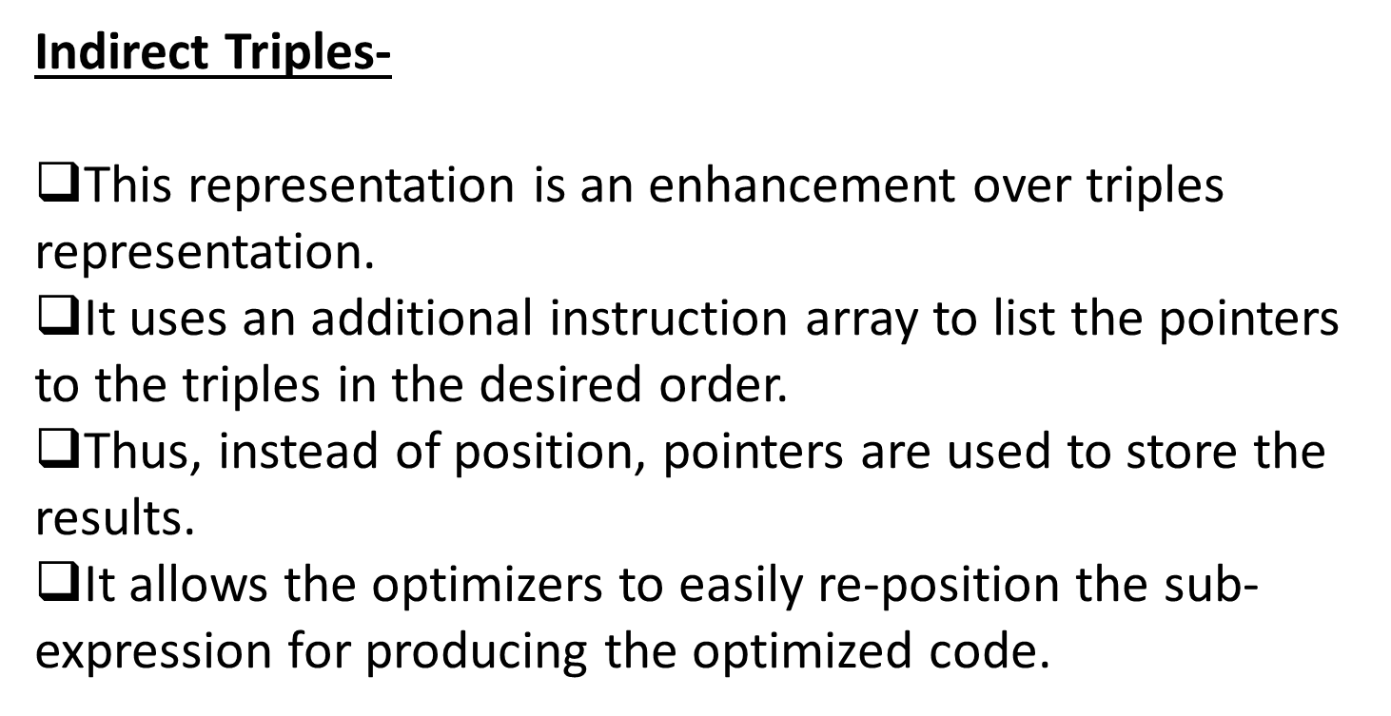

Slide 39
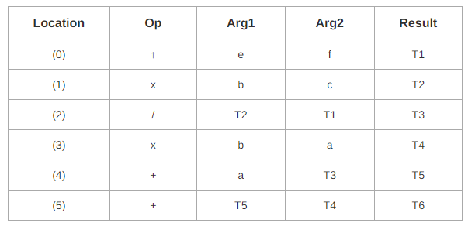
Translate the following expression to quadruple, triple and indirect triple: a + b x c / e ↑ f + b x a
Three Address Code for the given expression is-
T1 = e ↑ f
T2 = b x c
T3 = T2 / T1
T4 = b x a
T5 = a + T3
T6 = T5 + T4

Slide 40
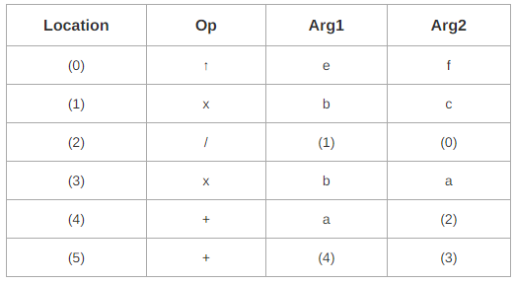

Slide 41
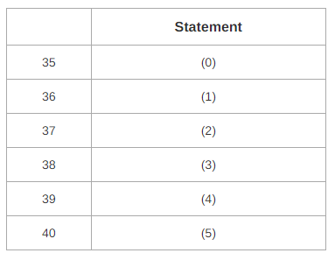
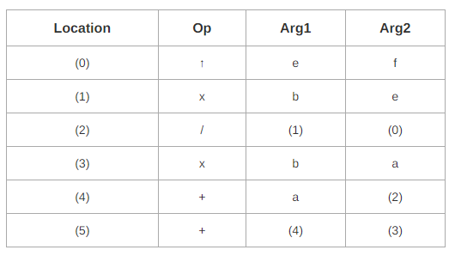
1869-9391

Slide 42
Homework problem :
Implement a three address code for a = b * -c + b * -c using quadrapuples,triples and indirect tripples

Slide 43
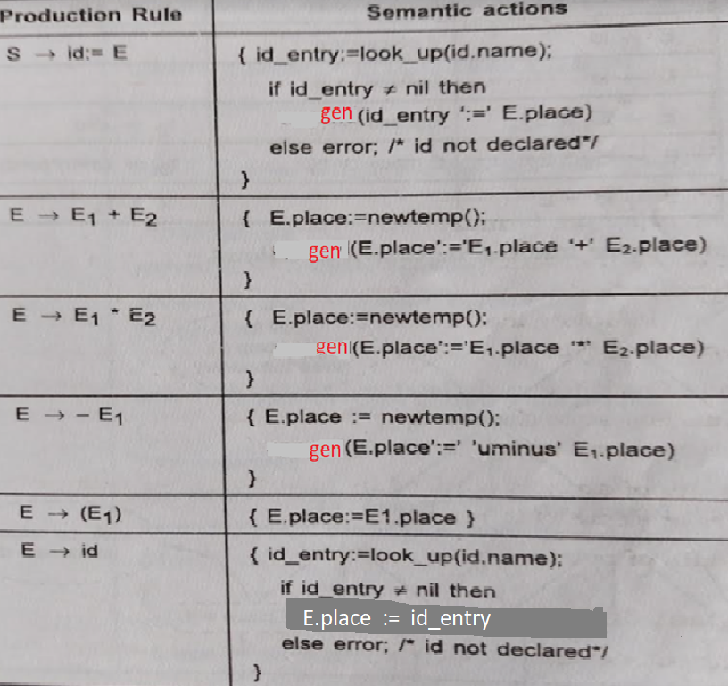
Syntax-Directed Translation into Three-Address Code for assignment statement :

Slide 44
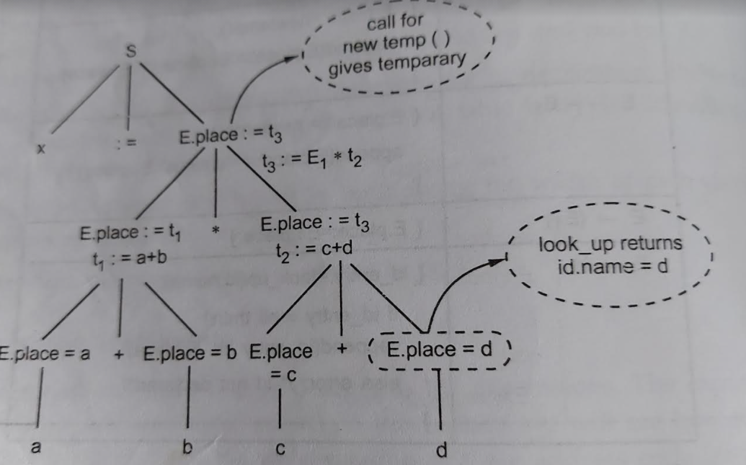

Slide 45
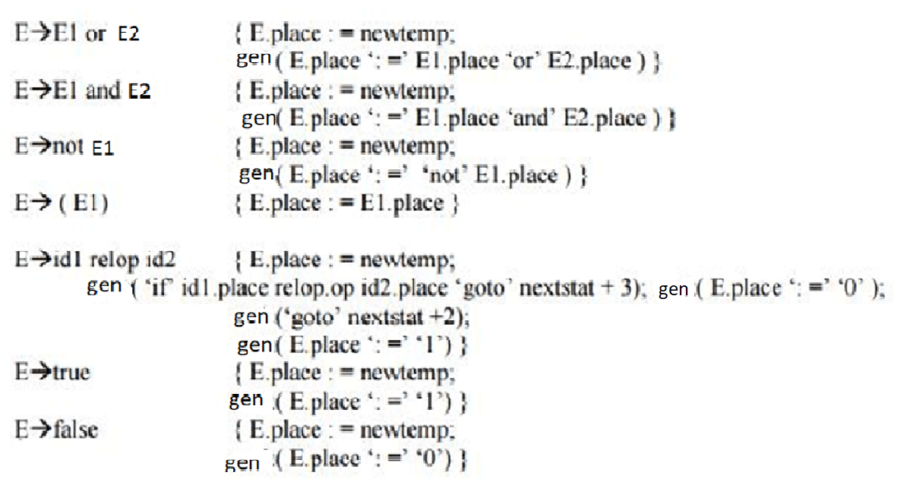
Three address code(3AC) for Boolean expressions using SDD

Slide 46
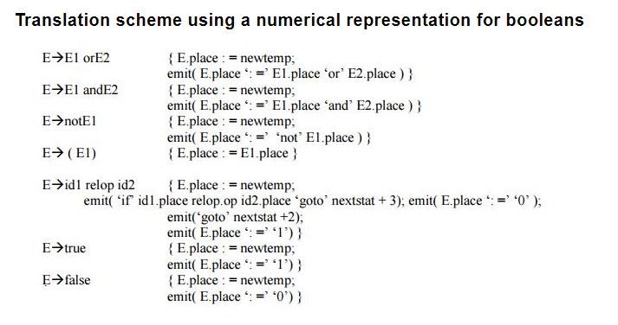
Three address code(3AC) for Boolean expressions using SDD

Slide 47
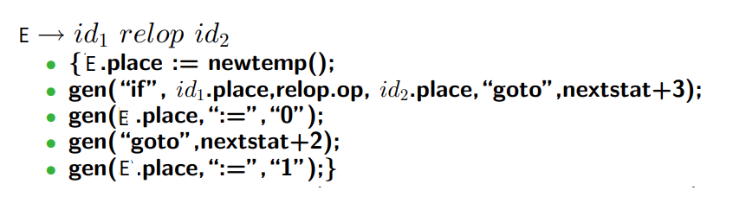
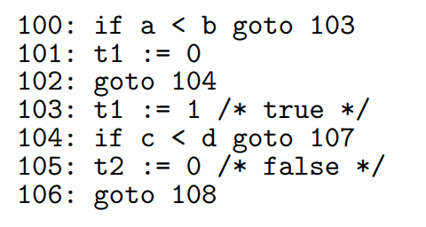
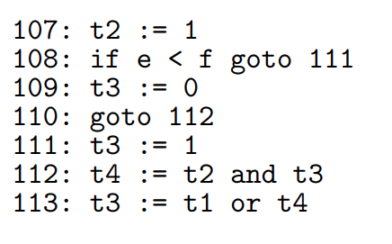
into 3AC
Three address code

Slide 48
Generate a three address code for x =a && b ||c

Slide 49
Three address code for flow of control statements
Production | Semantic Rules
S → if E then S1 | E.true := newlabel() E. false := s.next S1.next := s.next S.code := E.code || gen(E.true “:”) || s1.code
S → if E then S1 else S2 | E.true := newlabel() E. false := newlabel() S1.next := s.next S2.next := s.next S.code := E.code || gen(E.true “:”) || s1.code || gen(“goto” S.next) || gen(E.false “:”) || s2.code
S → while E then S1 | S.begin := newlabel() E.true := newlabel() E. false := s.next S1.next := S.begin S.code := gen(S.begin “:”) || E.code || gen(E.true “:”) || s1.code || gen(“goto” S.begin)

Slide 50
flow of control statements

Slide 51
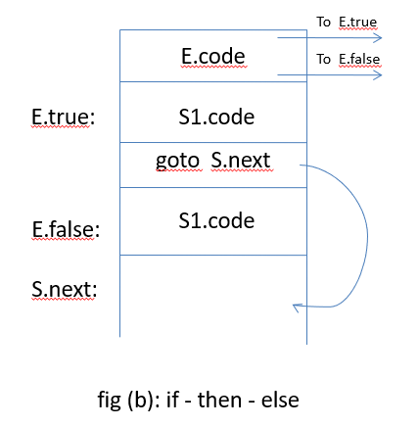
flow of control statements

Slide 52
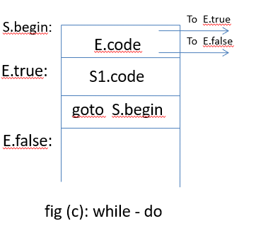
flow of control statements

Slide 54
Run time environment
The run time environment is the structure of a target machine which is used to manage memory and maintain information to guide the programs execution process.
Run-Time Storage Organization
The run time memory organization is a
layout in memory of an executable program .

Slide 55
Run-time storage organization
Run-time storage can be subdivide to hold the different components of an executing program:
Generated code
Dynamic data-object- heap
Static data objects
Automatic data objects- stack
code
storage space that won’t change: global data, constant, static code ...
Static Data
Stack
Data objects allocated at run-time. (Activation Records)
dynamic space
Free memory
For activation records: local data, parameters, control info, ...
Heap
used for data whose lifetime is not as easily described

Slide 56
Run time environment
The code area contains object code
For most languages, It is fixed in size and read only.
The static area contains data (not code) with fixed addresses (e.g., global data)
It is in Fixed size for static data, and it may be readable or writable.
The stack contains an AR (activation record) for each currently
active procedure
Each AR usually fixed size, contains locals.
The Heap contains all other data ie., whose lifetime is not described
Dynamic Data Structures
In C, the heap is managed by malloc and free functions.
In java , the new keyword is used for heap memory.

Slide 57
Activation Record
The returned value of the called procedure is returned in this field to the calling procedure. In practice, we may use a machine register for the return value.
The field for actual parameters is used by the calling procedure to supply parameters to the called procedure.
The optional control link points to the activation record of the caller.
The optional access link is used to refer to nonlocal data held in other activation records.
The field for saved machine status holds information about the state of the machine before the procedure is called.
The field of local data holds data that local to an execution of a procedure..
Temporary variables are stored in the field of temporaries.
return value
actual parameters
optional control link
optional access link
saved machine status
local data
temporaries

Slide 58
Storage allocation
The different ways to allocate the memory are :
Static storage allocation
Stack allocation
Heap allocation

Slide 59
Static storage allocation
In static allocation, names are bound to storage locations.
If memory is created at compile time then the memory will be created in static area and only once.
Static allocation supports the dynamic data structure that means memory is created only at compile time and deallocated after program completion.
The drawback with static storage allocation is that the size and position of data objects should be known at compile time.
Another drawback is restriction of the recursion procedure.

Slide 60
Stack Storage Allocation
In static storage allocation, storage is organized as a stack.
An activation record is pushed into the stack when activation begins and it is popped when the activation end.
Activation record contains the locals so that they are bound to fresh storage in each activation record. The value of locals is deleted when the activation ends.
It works on the basis of last-in-first-out (LIFO) and this allocation supports the recursion process.

Slide 61
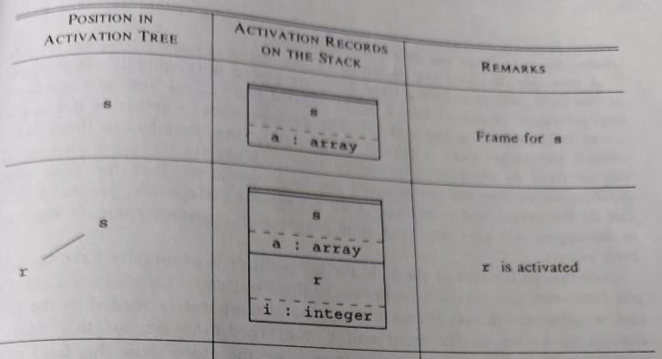

Slide 62
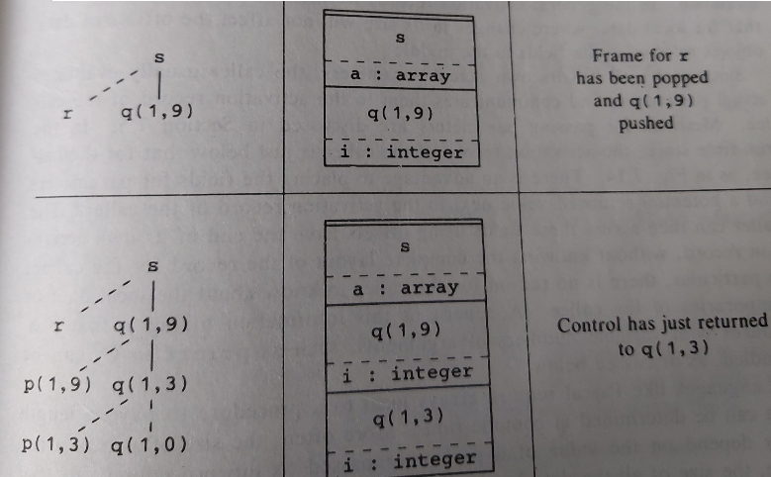

Slide 63
Heap Storage Allocation
Heap allocation is the most flexible allocation scheme.
Allocation and deallocation of memory can be done at any time and at any place depending upon the user's requirement.
Heap allocation is used to allocate memory to the variables dynamically.
Heap storage allocation supports the recursion process.

Slide 64
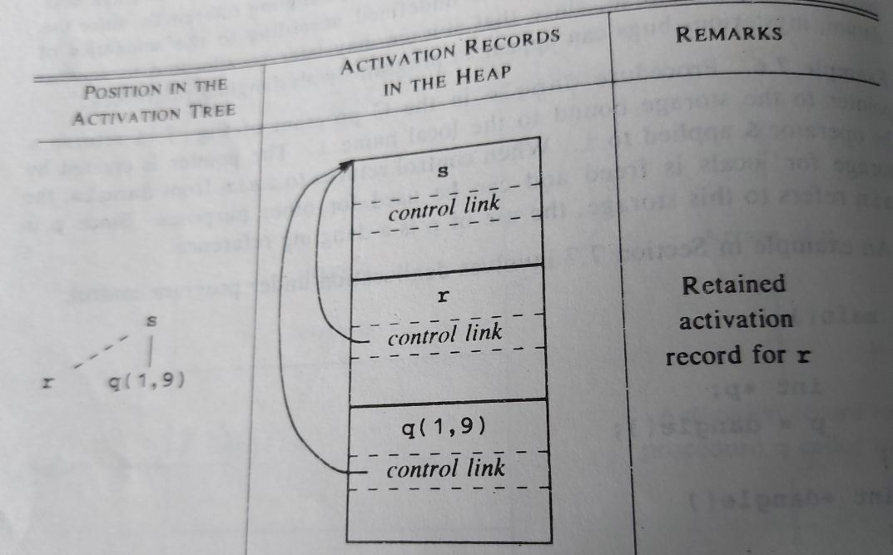
Heap Storage Allocation

Slide 65
END of IVth UNIT
THANK YOU

